Slide 1
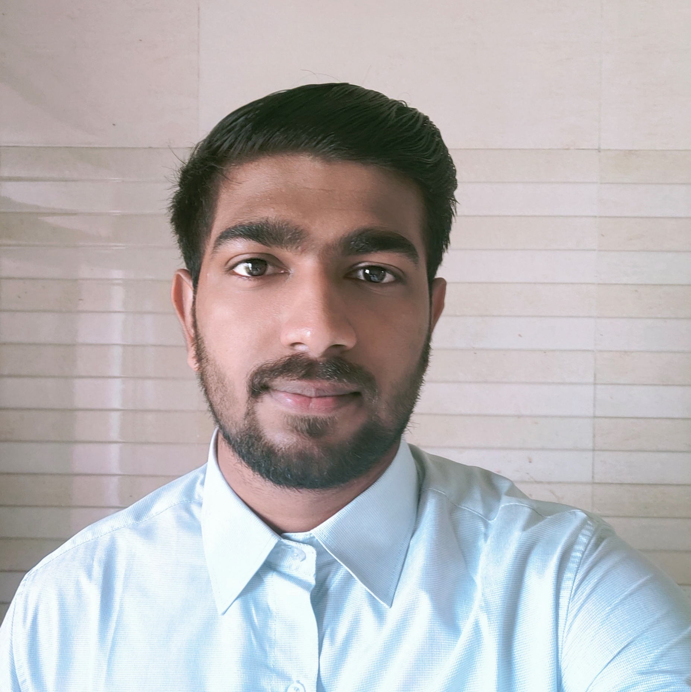

SUMIT GANGOTRI
Analyst/Software Engineer
BACHELOR OF ENGINEERING
2017-2021
Skills: Java
Spring Boot
Spring MVC
Manual Testing
MERN Stack:
React
Database:
Sql database:Mysql
Web Technologies:
HTML5
CSS3
Javascript
AddOns:
Github
Maven
Postman
SoapUi
Additional skills:
Quick Learner
Team management
Mumbai
sumit.rajesh-gangotri@capgemini.com
+91 8149603242
A4
Eager to work in a team of dedicated people and serve a key role in the enhancement and development of the project.
Software Engineer who is Good in frontend and backend and integration with intuitive problem-solving skills. Passionate about implementing and launching new projects.
Ready to learn new technologies and implement them to further improve my knowledge.
Has working knowledge on React and Java Microservice Development using Spring framework on an intermediate level.
Check out my work on GitHub
https://github.com/SumitGangotri
Shopping cart system:
Completed end to end case study of shopping cart system along with JWT authentication, Swagger and payment testing. . Material-UI and REACT used for user interface.
PROGRAMMING IN JAVA from NPTEL
Certified in “PROGRAMMING IN JAVA”, a NPTEL Online Certificate Course with 70% .

